Slide 1
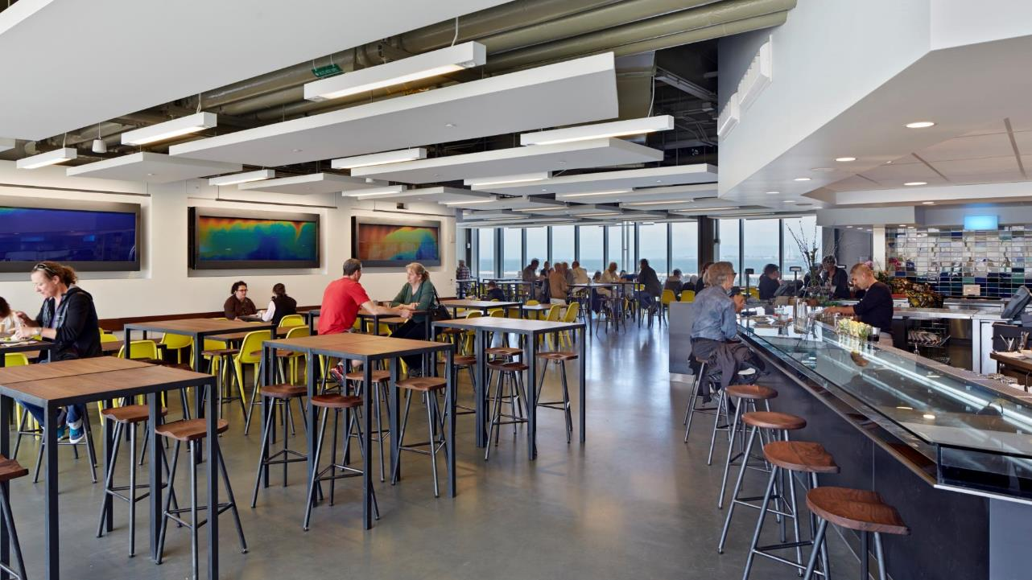



All Electric Commercial Kitchens
May 31, 2019
Brad Jacobson and Scott Shell
EHDD
Tarah Schroeder
RICCA
Richard Young
Frontier Energy / Fishnick
Chef Christopher Galarza
Chatham University
Hormoz Janssens
Interface Engineers
Notes:
Summarize intent of this meeting
Introduce our team of experts, and go around the room
Agenda

Slide 2
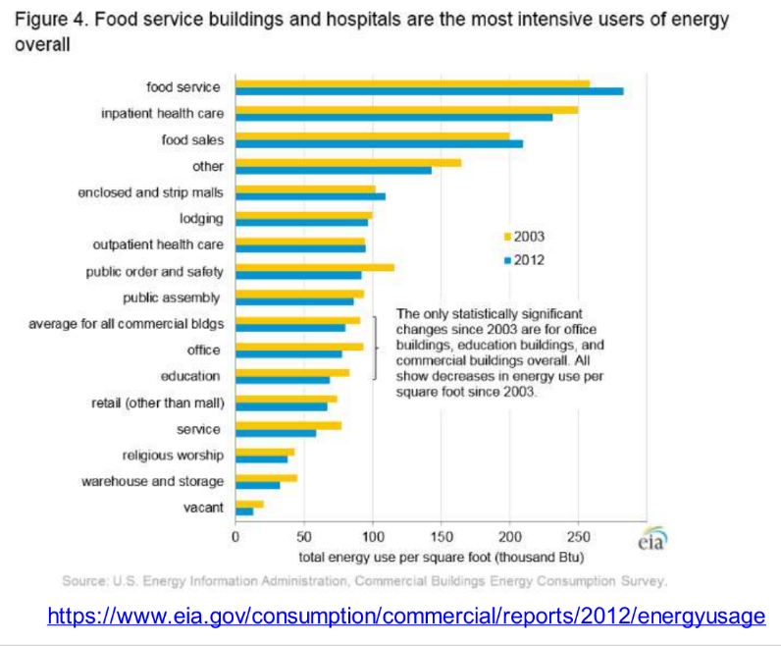

Slide 3
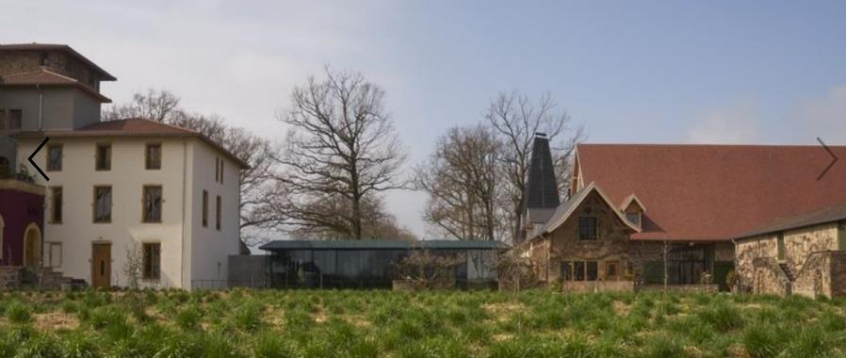
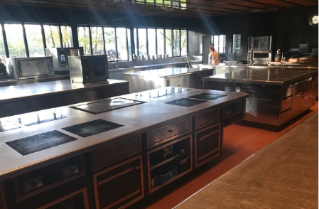
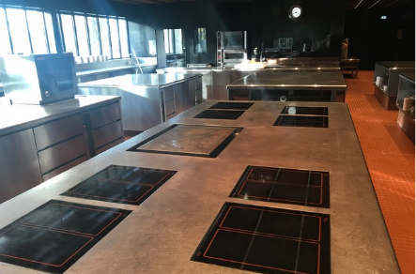
All Electric Kitchen
Troisgros Grande Maison Roane, France
Michelin 3 stars
https://troisgros.fr/page_3-maisons

Slide 4

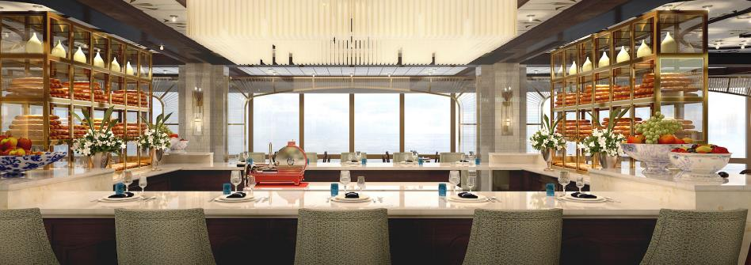

Cooking without fire
As fire is a major safety hazard on-board every ship, kitchen equipment is limited to electric stoves and ovens. But that doesn't mean the chefs at Harmony restaurant are unable to recreate wok hei, a key hallmark of Cantonese cooking.
https://guide.michelin.com/sg/travel/behind-the-scenes-top-chefs-spill-what-it-takes-to-cook-for-a-cruise-ship/news

Slide 5
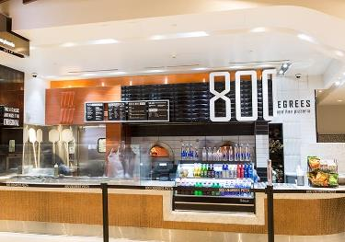
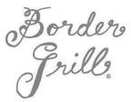
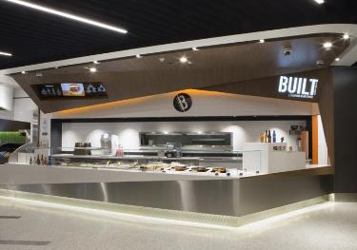
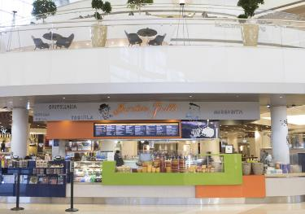

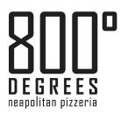

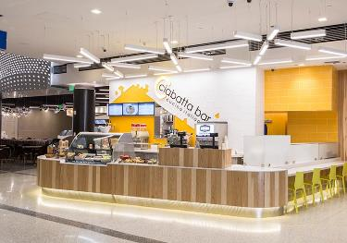

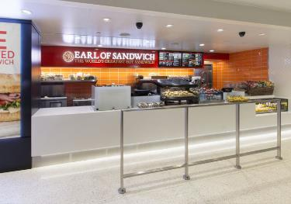

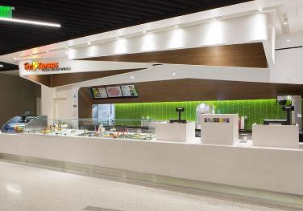
All Electric Restaurants at LAX
Bradley Terminal
Andre Salvadar, So Cal Edison food service expert helped these tenants adapt to all electric, he’s a great resource!

Slide 6

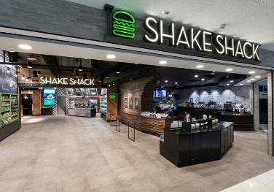

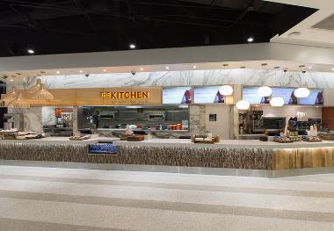
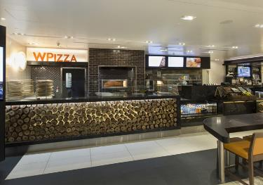



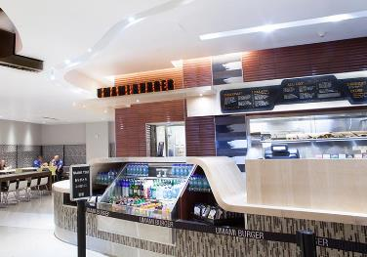

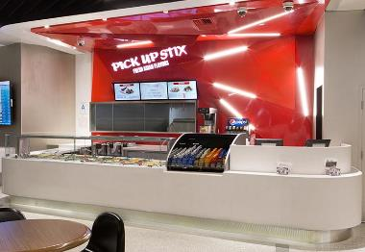
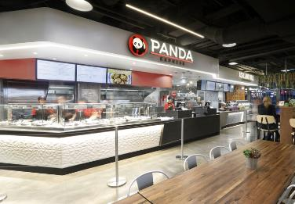
All Electric Restaurants at LAX
Bradley Terminal
https://www.foodserviceandhospitality.com/why-induction-cooking-is-the-hottest-trend-to-hit-restaurant-kitchens/

Slide 7



60% of full service restaurants in our territory are all electric
We’ve had success selling Wendy’s and McDonald’s on electric cooking
The new combi ovens, steam cabinets, holding cabinets and induction cooktops work great!

Slide 8



Has one electric kitchen under construction, Claire Lilienthal Elementary
Currently designing all electric kitchens at Clarendon, Hillscrest, and West Portal schools as all electric
Worked with chef and staff to understand induction cooking
Visiting Food Service Technology Center in San Ramon to give staff a hands-on look at the equipment
Doing some training with staff to get them accustomed to induction
Bids for electric equipment are coming in cheaper than gas
Biggest energy hogs are the fryers and also make the least healthy food, so promoting other equipment is healthy!

Slide 9
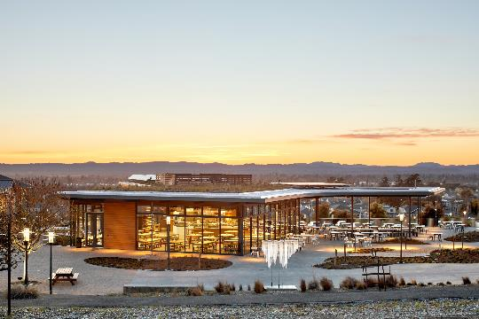
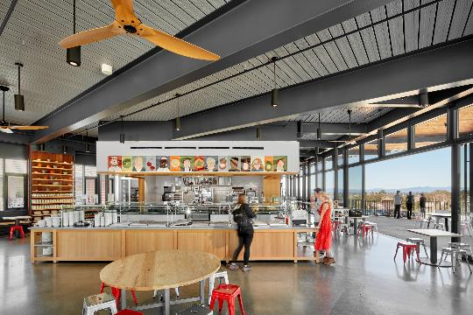
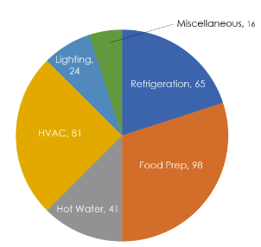
Sonoma Academy – Food Service
Sonoma Academy Janet Durgin Guild + Commons / Net Postive Energy, LEED Platinum Goal, LBC Full Certification, Well Building Certification
WRNS Studio
Michael David Rose
Electrification of Cooking
Starting Point:
  Average Food Service Facilities EUI 250-400
For a typical 20,000 ft^2 food service facility:
  1,900,000 kWh (averaged at EUI = 325)
  1,520 kW (@1,250 kWh per installed kW)
From Interface Engineering

Slide 10

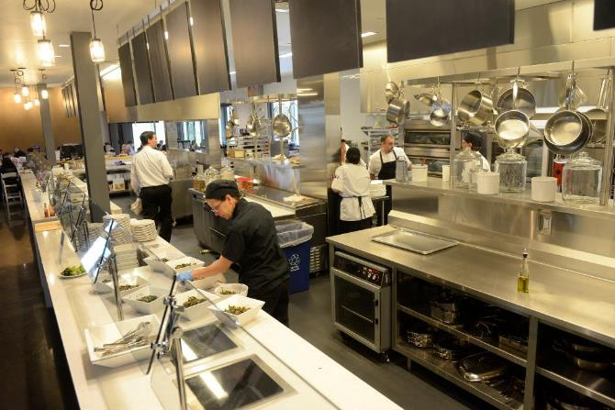
Chatam University Dining Commons
All electric kitchen, 250 meals 3 times a day
The chef was initially reluctant, and had never cooked on induction before
It took some time to adjust to new kitchen
But now he loves it and says he will never go back to gas

Slide 11
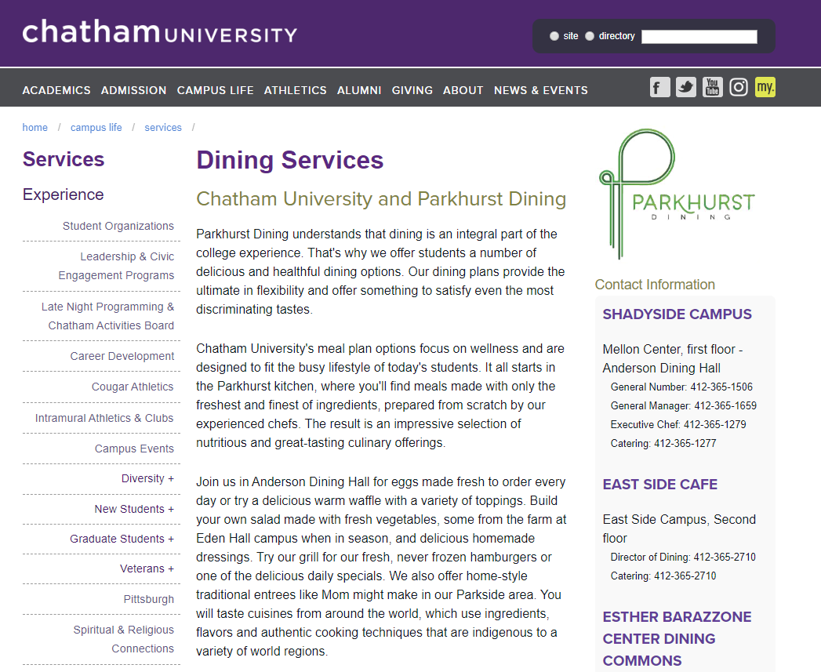
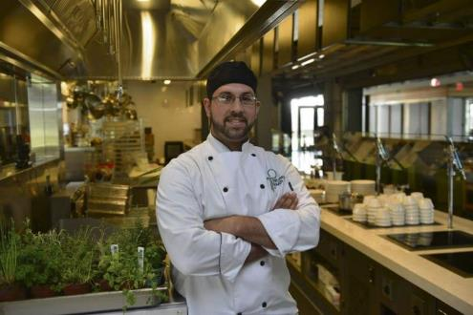

Case Study: Chatham University All Electric Dining Hall
Christopher A. Galarza
Chef Manager
Parkhurst Dining

Slide 12
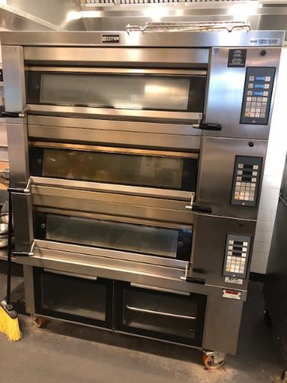
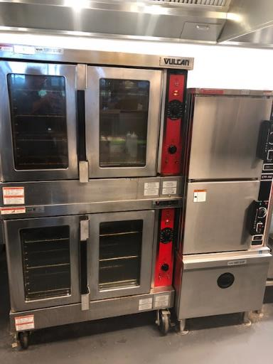
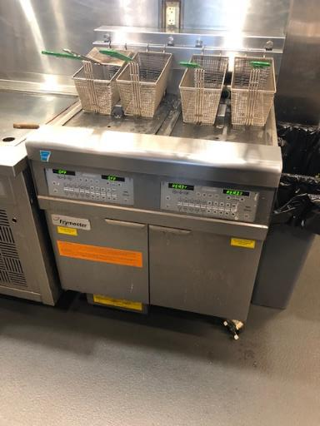
Chatham University All Electric Dining Hall

Slide 13
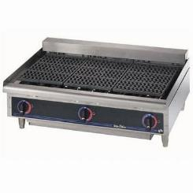
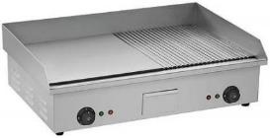
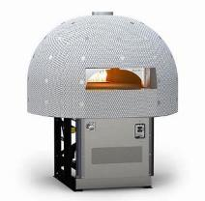
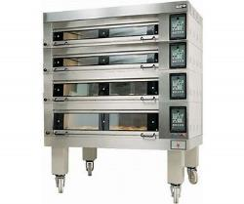
What does it mean for a kitchen to be all electric?
Induction ranges
Equipment availability
Different style of food preparation
Different approach to turning on the kitchen
Energy / water efficiency and beyond
Notes:
Electric char broiler does not perform the same as gas
Change style of cooking
Efficiency with griddle is not as great, 40-60% which means it is still less to operate with gas
from convection to combi oven
Look at peak electric demand – anything that was gas is now electric and what impact does that have. Is there concern with time of use?

Slide 14
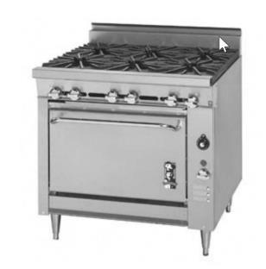
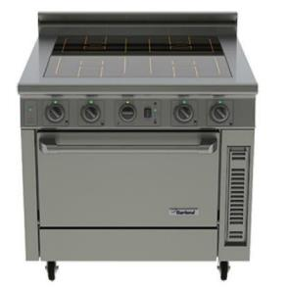
Vs.
Gas ranges are 35% efficient at most
Induction ranges are 85%+ efficient in heat use = savings to HVAC system
Notes:
Induction is thermostatic
Induction heats up quickly with clear off and on.

Slide 15
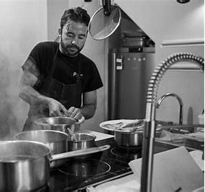
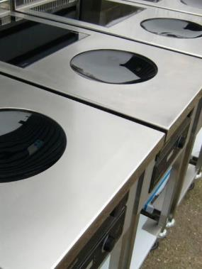
Induction Ranges
Induction heat-up performance is comparable with a gas range
Induction is more precise than a gas range = Reproducibility of consistent product with greater control
Induction saves money on cleaning, labor, and is Cal/OSHA Heat Life Safety code compliant
Induction not available yet for ovens
Notes:
Induction is thermostatic
Induction heats up quickly with clear off and on.

Slide 16
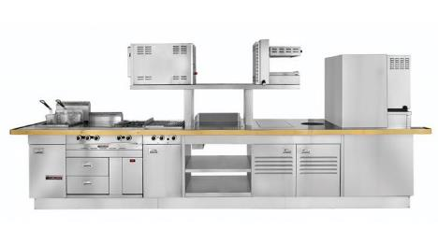
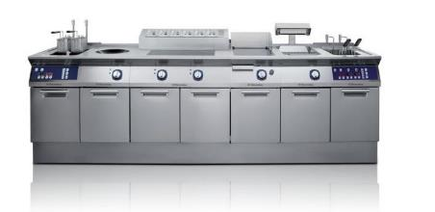
US Manufacturers: Garland, Electrolux, Vollrath, Cooktek
European Manufacturers: MKN, Molteni
Electrolux 700XP range
Garland suite
Notes:
Induction is thermostatic
Induction heats up quickly with clear off and on.

Slide 17
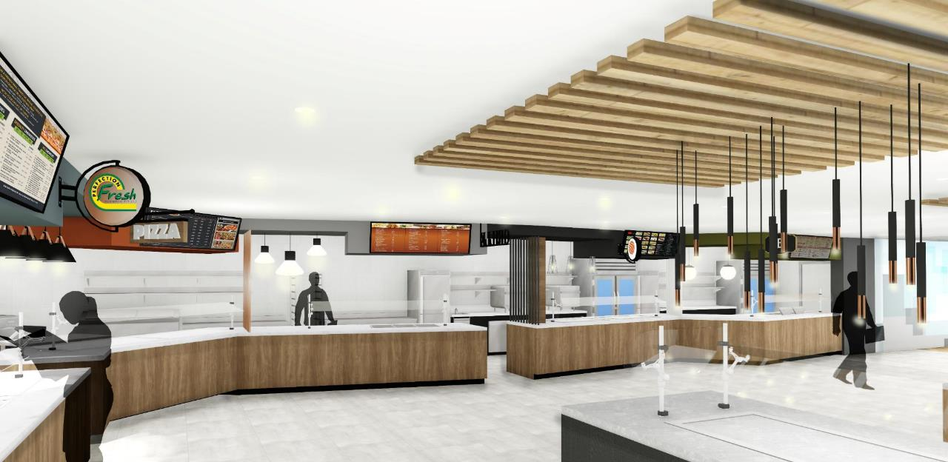
Blue Cross Blue Shield
Lincoln Impinger Pizza Oven
Keating Griddles
Spring USA Drop-in Induction
Frymaster Fryers
Groen Kettles and Tilt Skillets

Slide 18
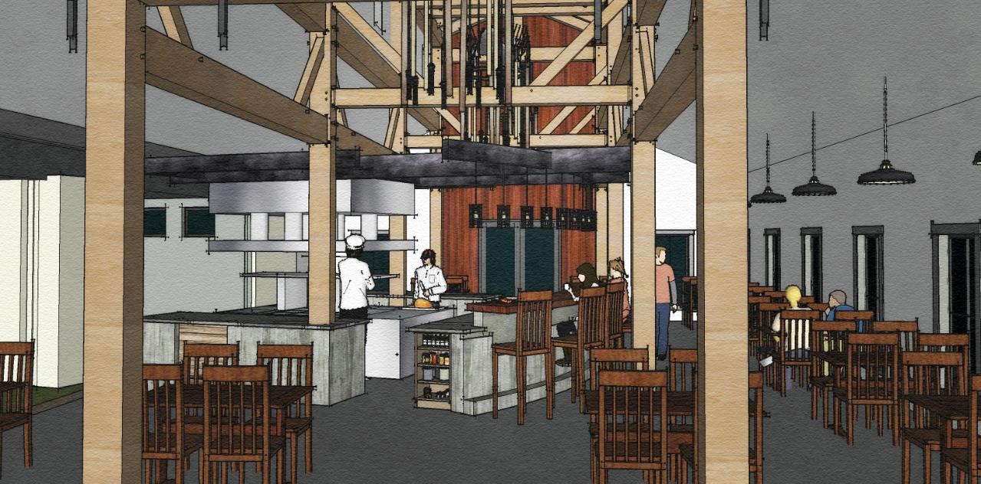
RE Farm
5,672 SF / Approx. 100 Meals Daily
Living Building Challenge
24,000 kWh/y - entire building
12,500 kWh/y - kitchen only
Notes:
80 seat banquet/restaurant
Living Building Challenge
Net Zero Energy with net metering
Financing thru banks and state energy fund
Started with how much energy is available to use per year
Chef worked with gas for 35 years
Induction heats cooking vessel instead of the air around it, 85% more efficient
Clear on and off, not as slow as electric ranges
Forces cooks and chefs to change style in the kitchen
80 seat banquet/restaurant
Submeter energy: suite 1, suite 2, kitchen, building
Submeter water: irrigation, kitchen, building
Submetering of energy: suite 1, suite 2, kitchen, building
Submetering of water: irrigation, kitchen, building

Slide 19

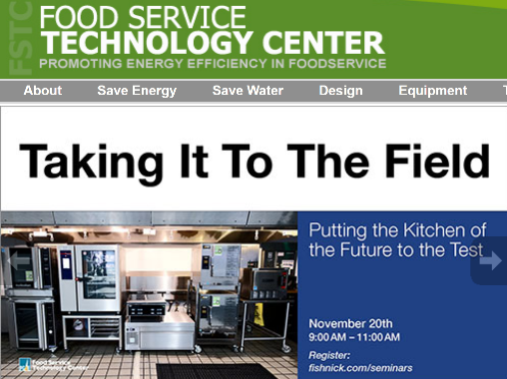

“Induction Cooking in Commercial Kitchens” 9/13/18
Richard Young, Food Service Technology Center
Really exciting innovations in commercial induction kitchen equipment
Fast, flexible, modular, efficient, highly controllable, safer, easier to clean, lower heat in kitchen
A new generation of modular highspeed equipment allowing for small highly productive kitchens
European and Asian kitchens are further along in adoption

Slide 20

Richard Young continued;
A gas range is 25% efficient, an Induction range is 90% efficient
Electricity is more expensive, but due to greater efficiency operational cost is about the same
Food holding is a great application, hold sauces and stocks at precise temperature
Soup in an Induction warmer doesn’t get caked on sides of container
Highly controllable temperature perfect of pastry chefs
Most equipment available in electric versions, a lot of equipment coming in from Europe
Electric ovens use standard resistance electric elements, so they cost more to operate than gas
Induction equipment costs more up front that gas, there can be some sticker shock
To make an entire kitchen electric, you really want to pay attention to efficiency
Chef’s usually refuse to consider induction because they’ve never tried it, once they do most like it
SaltCraft restaurant in Pleasanton all electric. At first chef’s were skeptical, now they love it
A number of high tech firms in silicon valley use all electric kitchens within office buildings

Slide 21
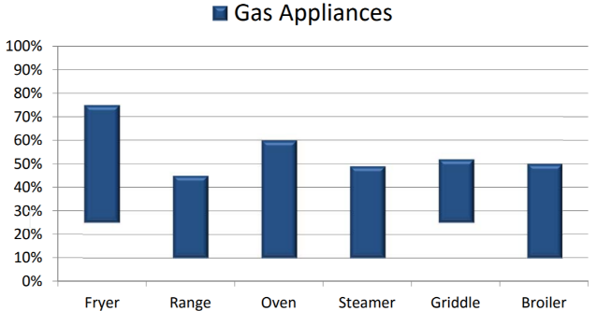
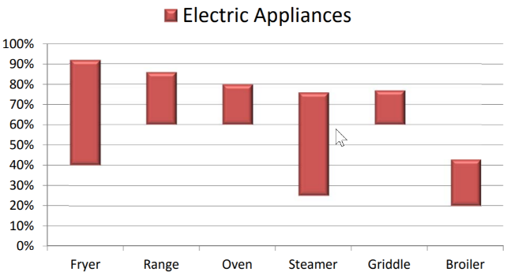
Huge Range in Efficiency!
Electric is More Efficient
https://fishnick.com/handouts/06232016/RYoung-Sustainability_Beyond_the_Plate-06232016.pdf

Slide 22


All Electric Kitchen - Porter Academy
250 Meals 3 Times per day

Slide 23
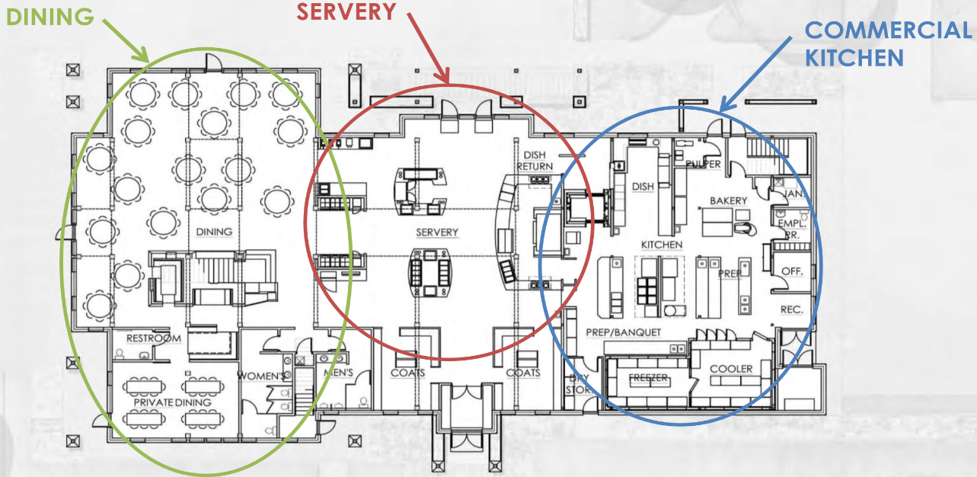

Justin Silverthron Food Service Consultant
http://www.advfoodsol.com/

Slide 24
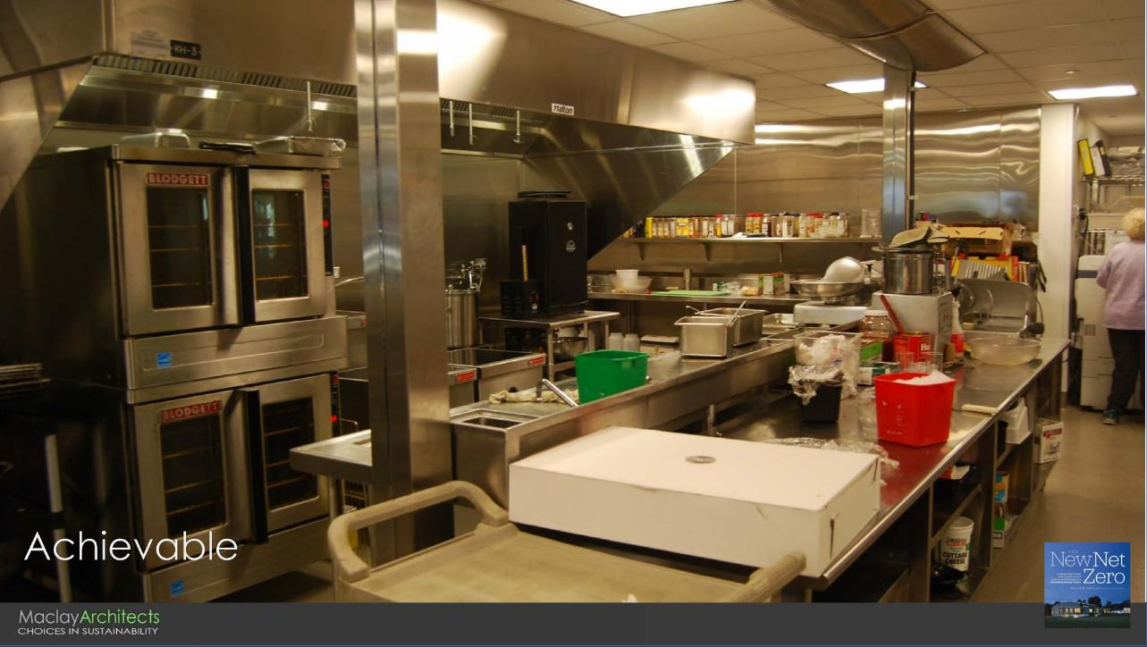

Slide 25
Resources
The smog in your kitchen: https://www.fresnobee.com/opinion/readers-opinion/article222726175.html
All electric commercial food service: https://drive.google.com/open?id=1CjrN62JqgffTzri3zeE3hwDqW9Zu80ws
All electric restaurant kitchens: https://www.foodserviceandhospitality.com/why-induction-cooking-is-the-hottest-trend-to-hit-restaurant-kitchens/
Zero carbon commercial construction: http://sanjoseca.gov/DocumentCenter/View/82909
https://www.motherjones.com/food/2019/07/can-chefs-learn-to-love-cooking-without-fire/
Zero Emissions All Electric Multifamily Construction Guide: https://fossilfreebuildings.org/ElectricMFGuide.pdf

